Slide 1
WEEK 2
Internship under dr gs javed sir
INTERN NAME - AFZAL MALIK
College/UNIVERSITY – ZAKIR HUSAIN COLLEGE OF ENGG. & TECH.
ALIGARH MUSLIM UNIVERSITY
COURSE- BACHELOR OF TECHNOLOGY (ELECTRONICS ENGG.)
YEAR – SECOND

Slide 2
WEEK 2 INTERNSHIP PLAN
Differential Pair simulation
Current Mirror simulation
Delay Cell simulation
Comparator simulation
SOFTWARE USED : LT Spice

Slide 3
SIMPLE CURRENT MIRROR
DESIGN AND SIMULATION using lt spice
Model file : 180n
SPECIFICATIONS
Iref=50uA is used for Id(M2) =500uA

Slide 4
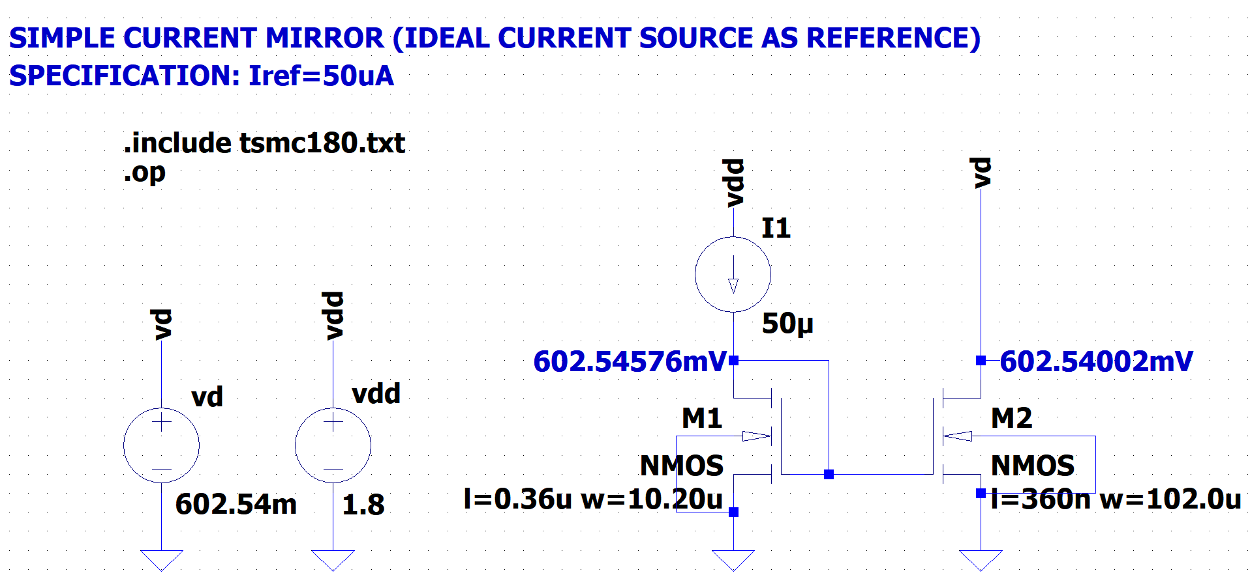
SCHEMATIC

Slide 5
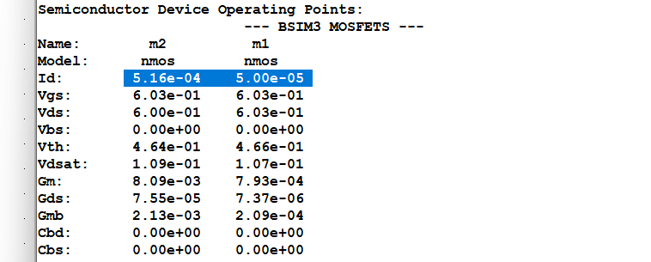
SPICE ERROR LOG
Iref= Id(M1) = 50uA AND Id(M2) = 516uA

Slide 6
SIMPLE CURRENT MIRROR
DESIGN AND SIMULATION using lt spice
Model file : 180n
SPECIFICATIONS
Iref=52.4uA is used for Id(M2) =524uA
Note: Ideal Current Source is replaced by Diode connected PMOS

Slide 7
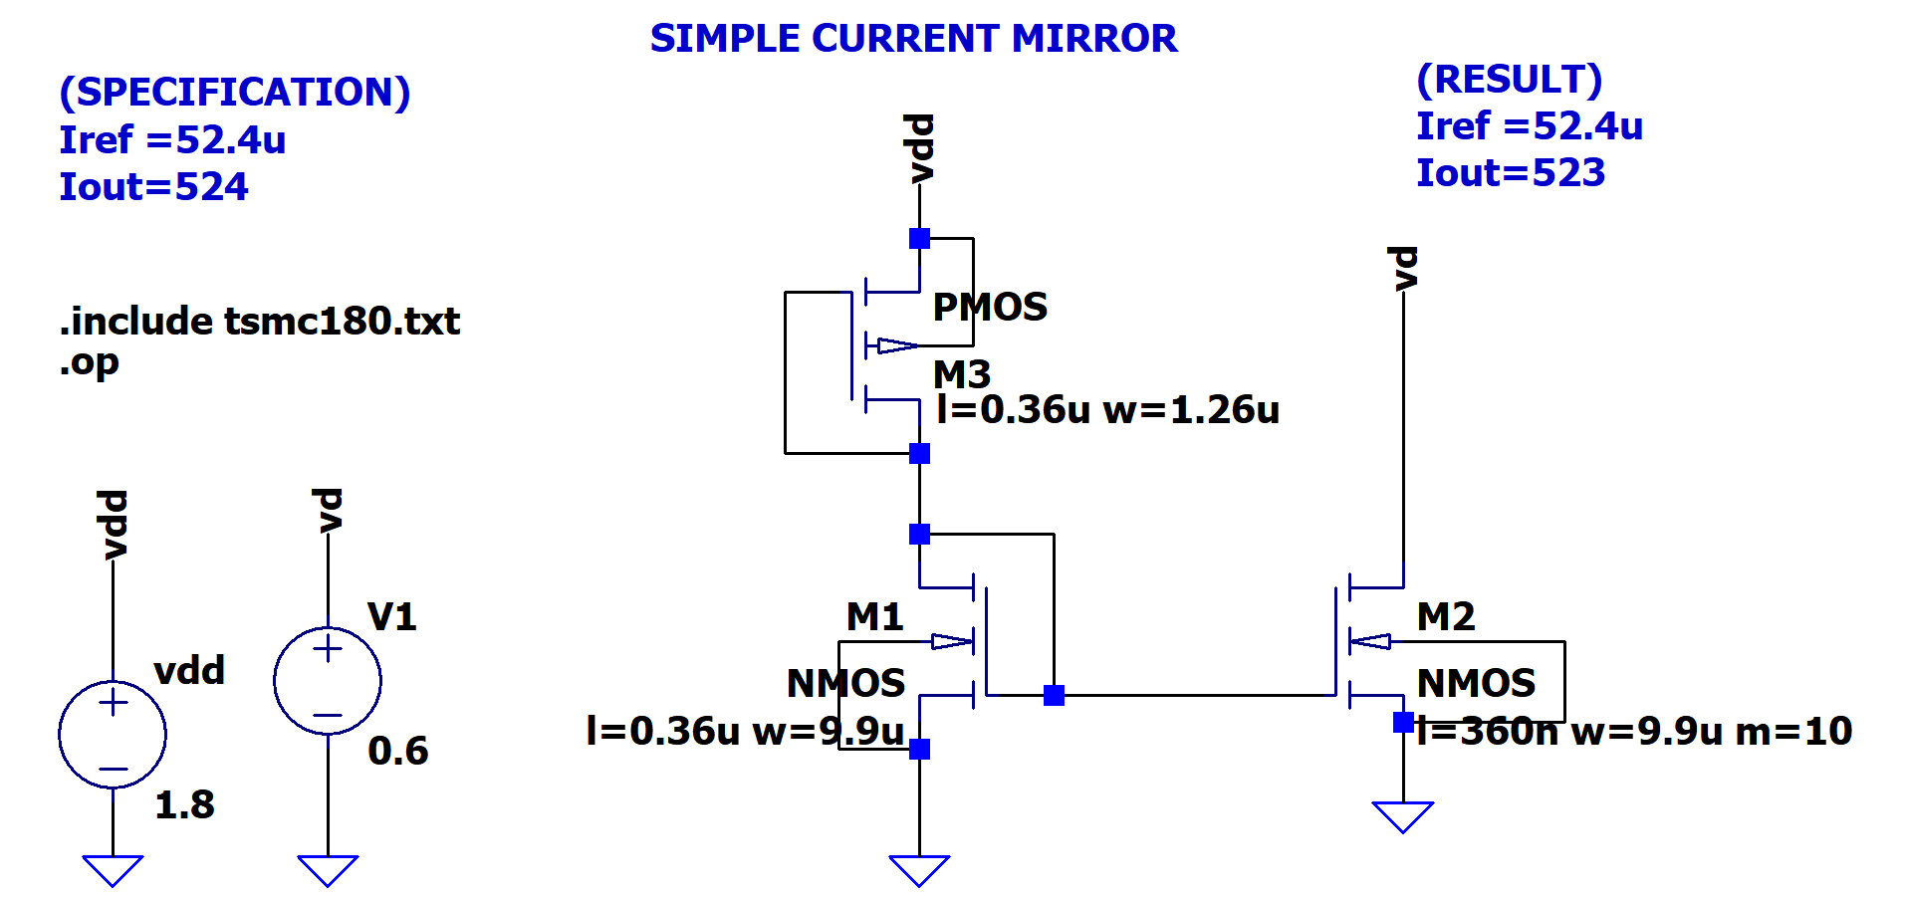
SCHEMATIC

Slide 8
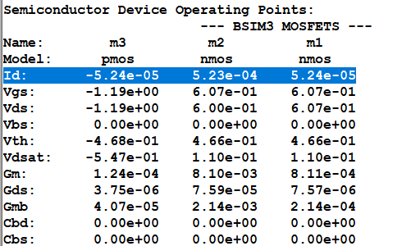
SPICE ERROR LOG
Iref= Id(M1) = 52.4uA AND Id(M2) = 523uA

Slide 9
CASCODE CURRENT MIRROR
DESIGN AND SIMULATION using lt spice
Model file : 180n
SPECIFICATIONS
Iref=50uA is used for Id(M2) =500uA

Slide 10
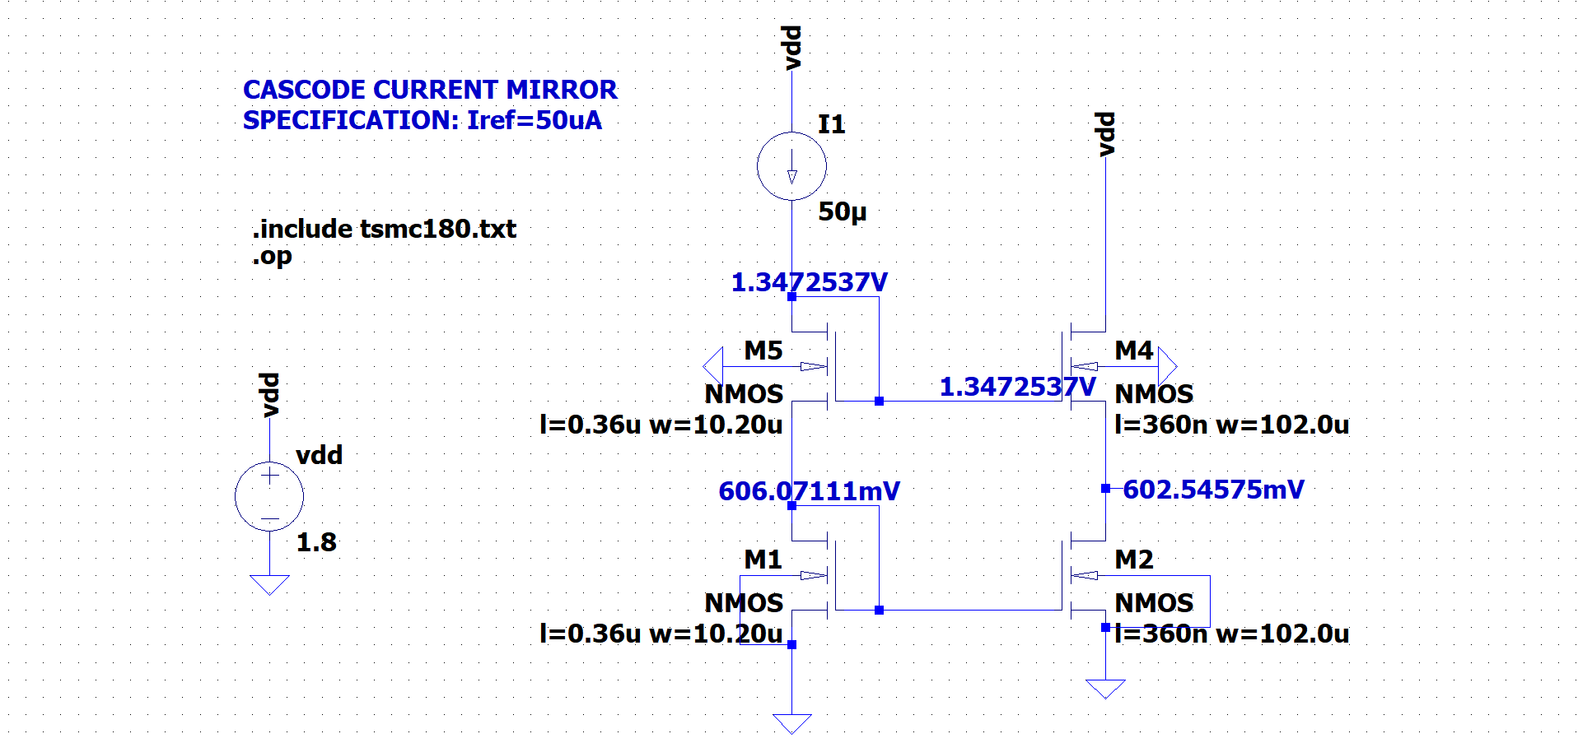
SCHEMATIC

Slide 11
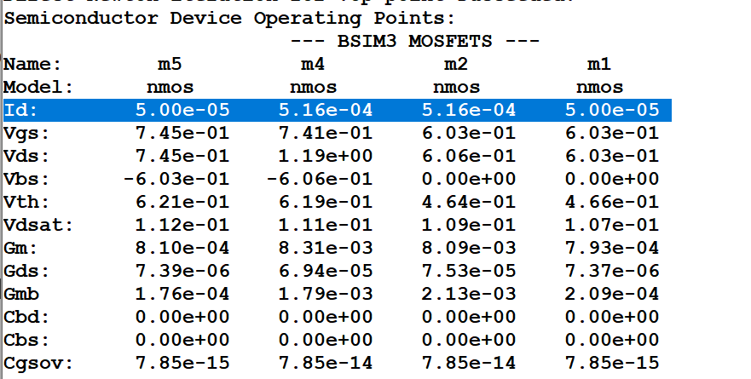
SPICE ERROR LOG
Iref= Id(M1) = 50uA AND Id(M2) = 516uA

Slide 12
DIFFERENTIAL PAIR
DESIGN AND SIMULATION using lt spice
Model file : 180n
SPECIFICATIONS
GBW= 1GHz
Gain = 10 at 100 MHz frequency

Slide 13
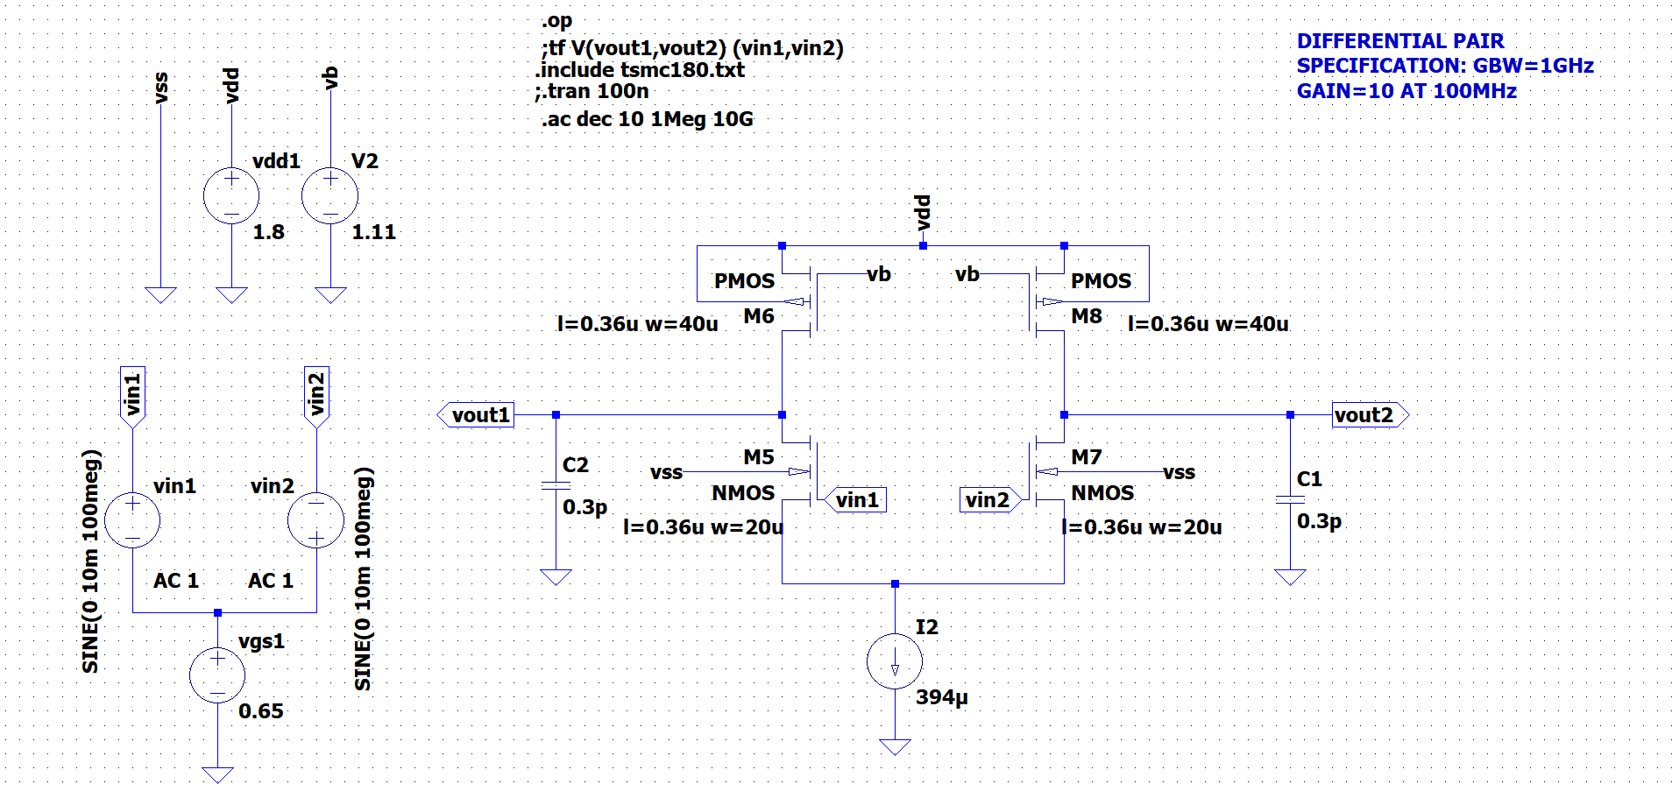
SCHEMATIC

Slide 14
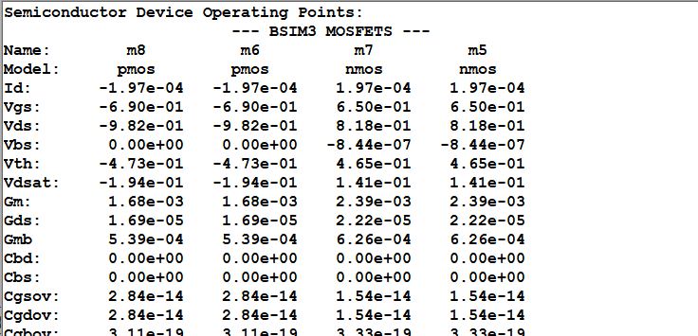
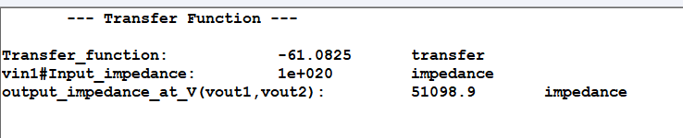
SPICE ERROR LOG

Slide 15
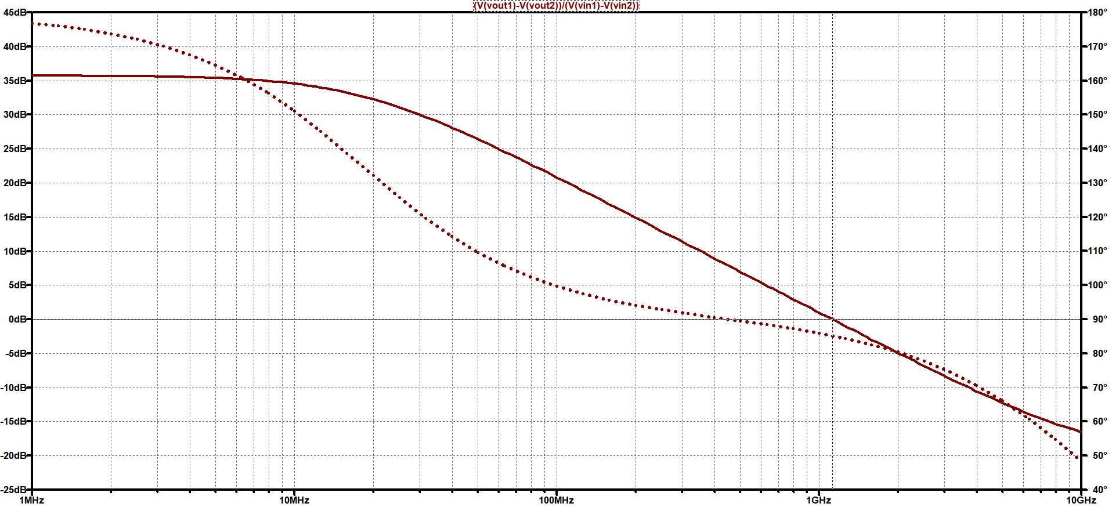
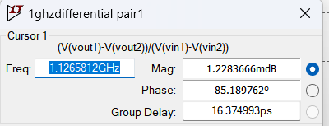
FREQUENCY RESPONSE
GBW=1.12GHz

Slide 16
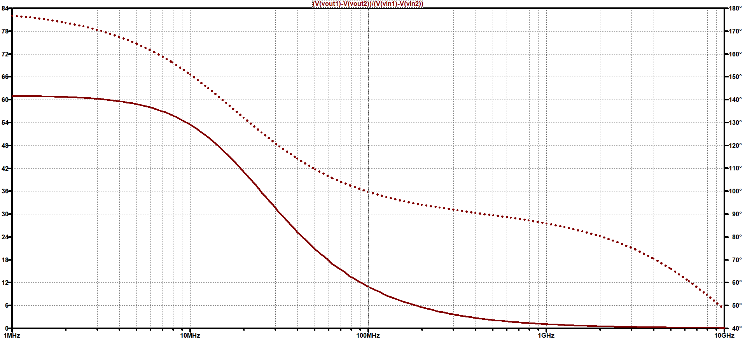
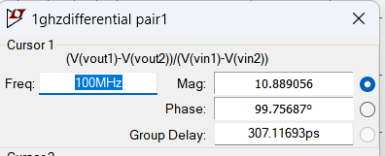
FREQUENCY RESPONSE
AT 100MHz Gain =10.88

Slide 17
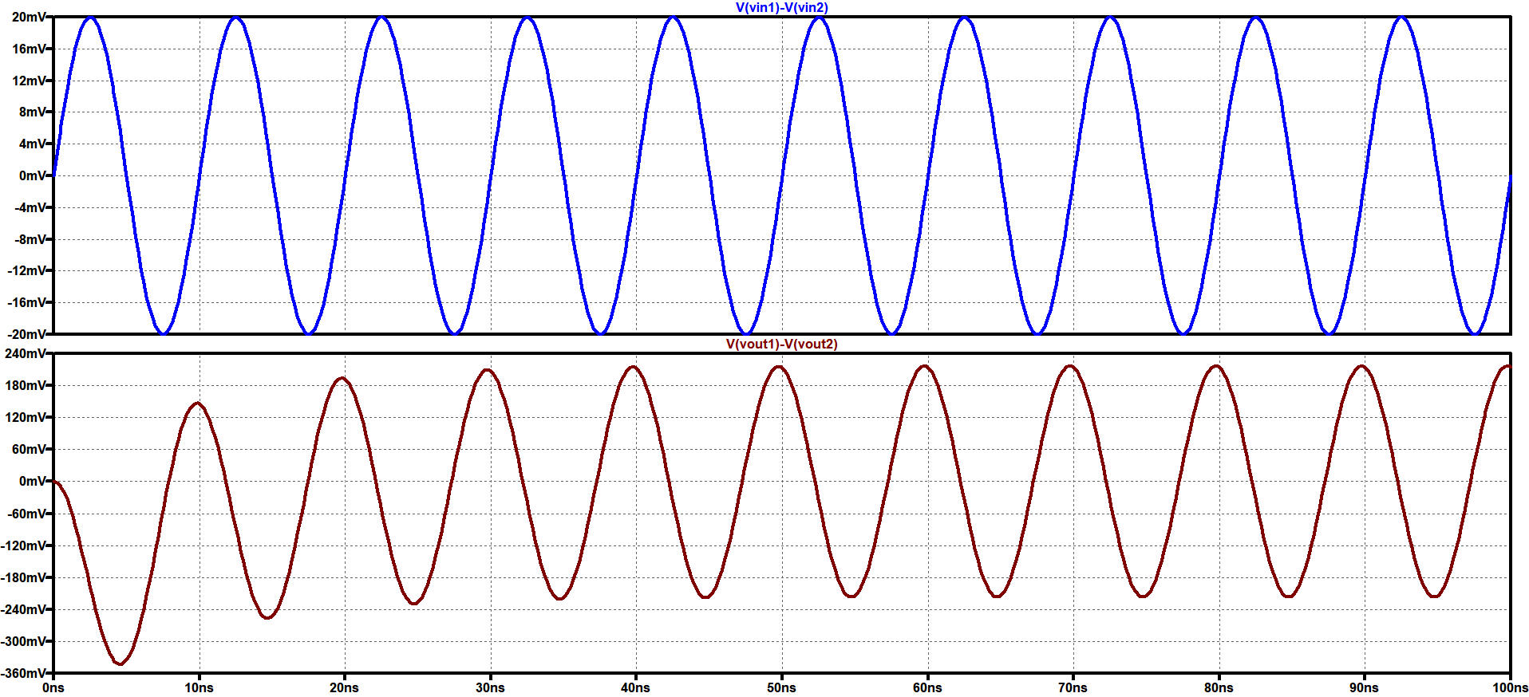
TRANSIENT ANALYSIS
If 10mV signal is given at 100MHz then we can observe from here Gain is nearly 10

Slide 18
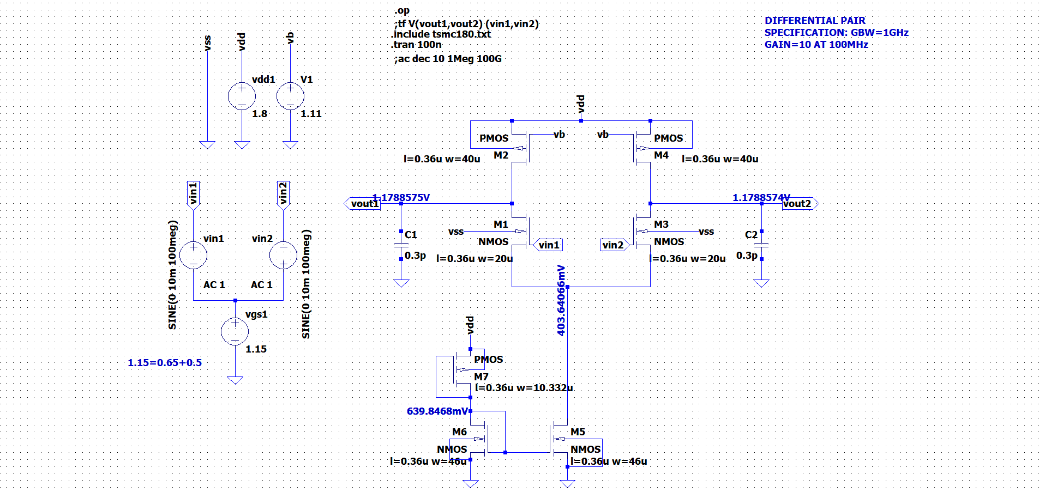
SCHEMATIC

Slide 19
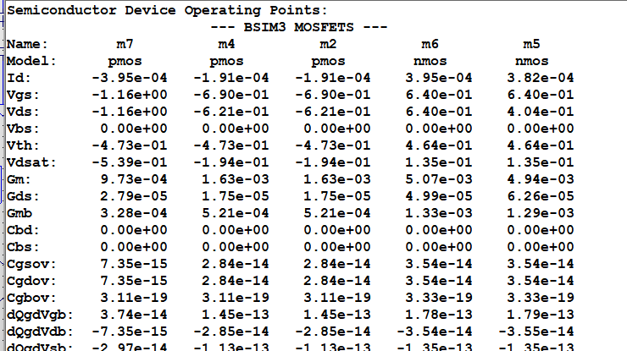
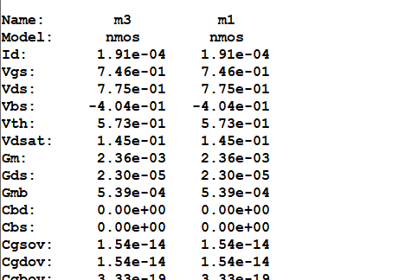
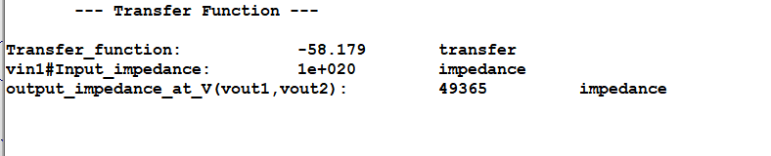
SPICE ERROR LOG

Slide 20
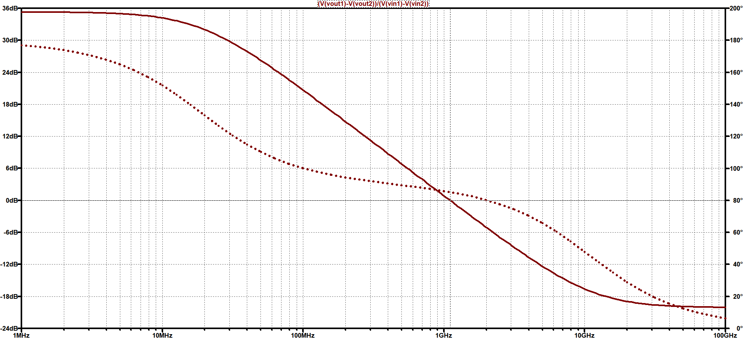
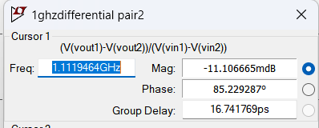
FREQUENCY RESPONSE
GBW=1.119GHz

Slide 21
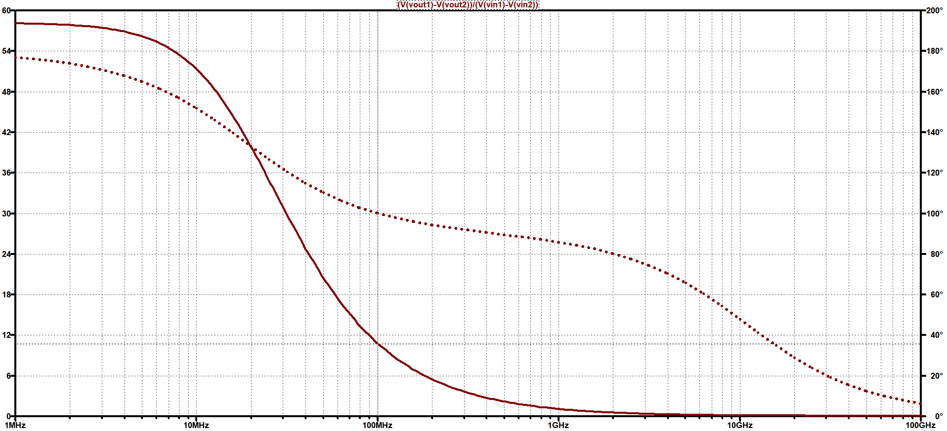
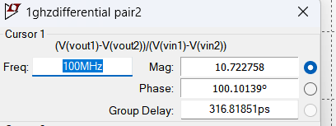
FREQUENCY RESPONSE
AT 100MHz Gain = 10.722

Slide 22
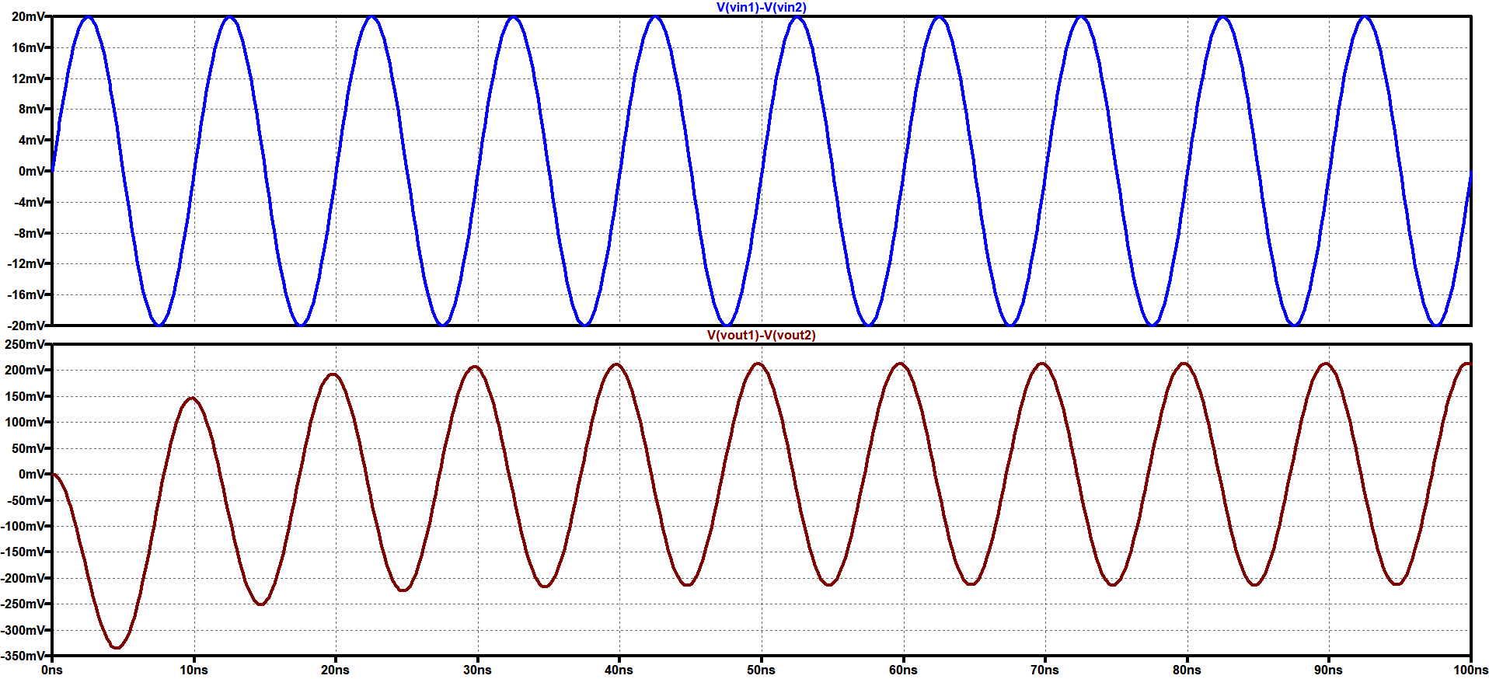
TRANSIENT ANALYSIS
If 10mV signal is given at 100MHz then we can observe from here Gain is nearly 10

Slide 23
THANK YOU

